Slide 1

NeuSym-RAG: Hybrid Neural Symbolic Retrieval with Multiview Structuring for PDF Question Answering
Ruisheng Cao*, Hanchong Zhang*, Tiancheng Huang*, Zhangyi Kang, Yuxin Zhang, Liangtai Sun, Hanqi Li, Yuxun Miao, Shuai Fan, Lu Chen, and Kai Yu

Slide 2
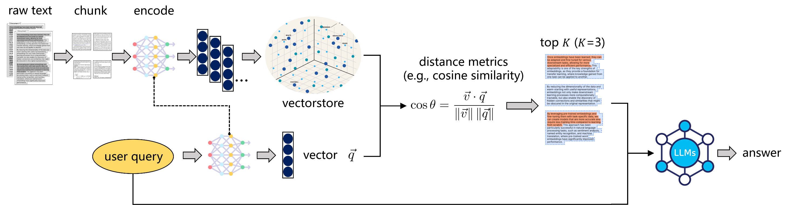
Motivation
Retrieval-based Question Answering System
single knowledge source

Slide 3
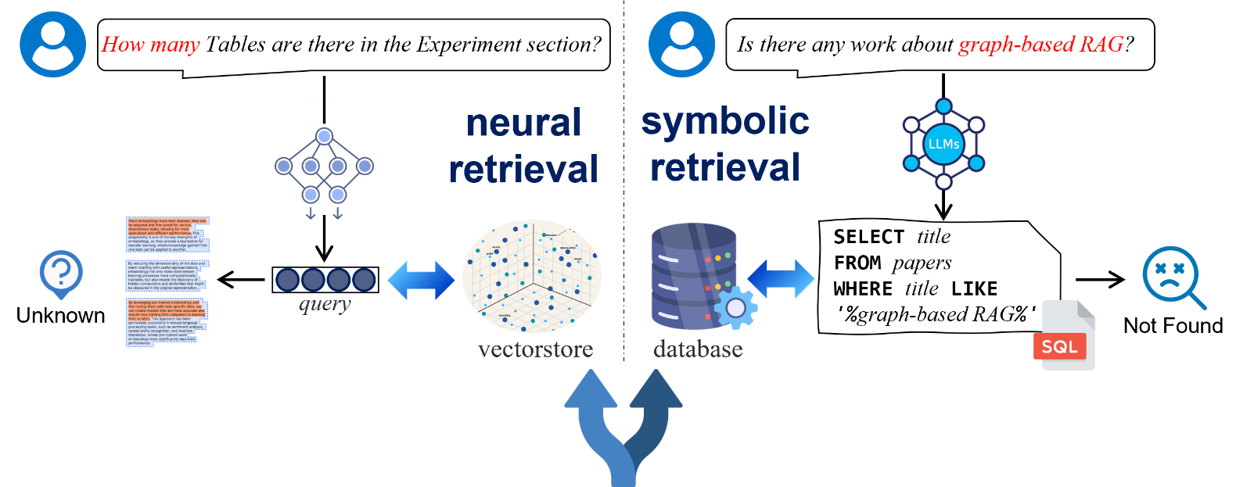
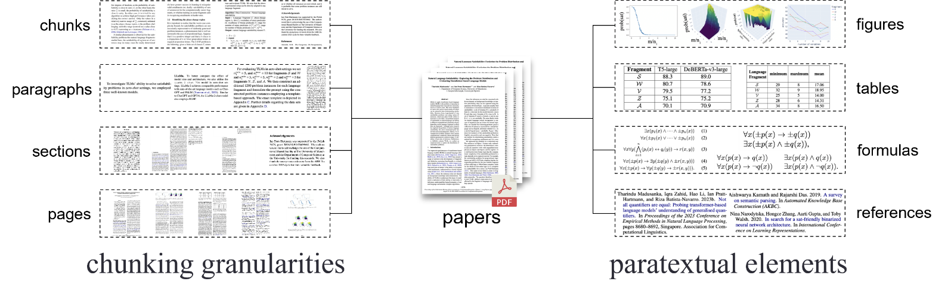
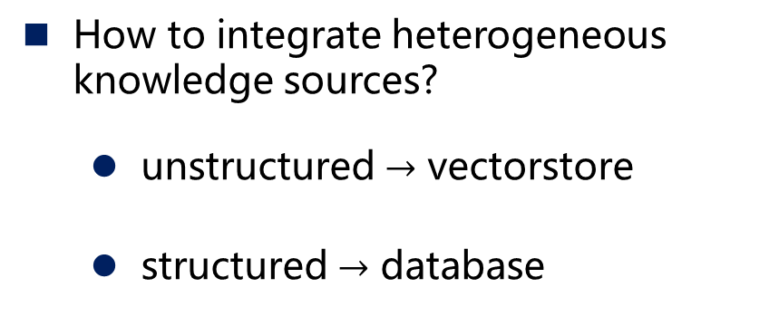
Motivation
How to segment and organize multiple views?
How to integrate heterogeneous knowledge sources?
  unstructured $→$ vectorstore
  structured $→$ database

Slide 4
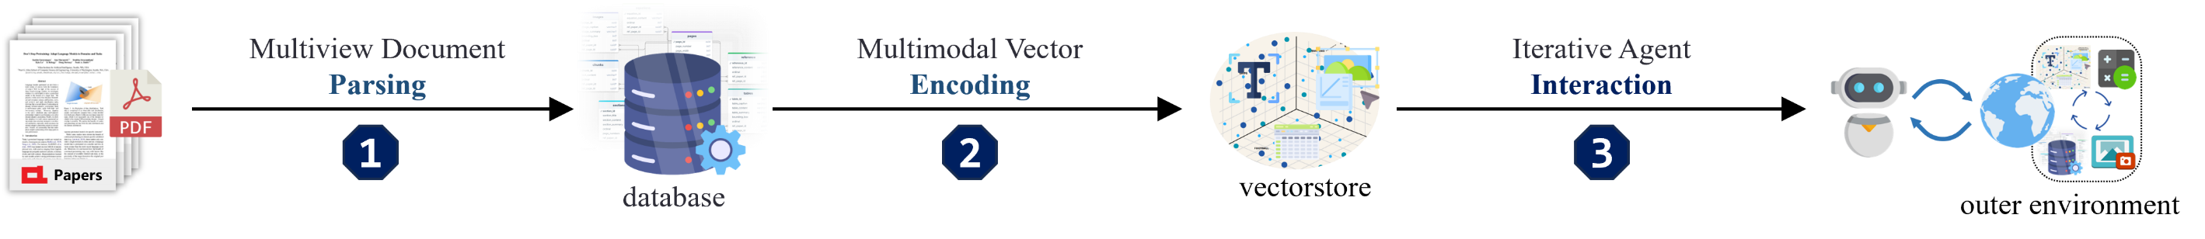
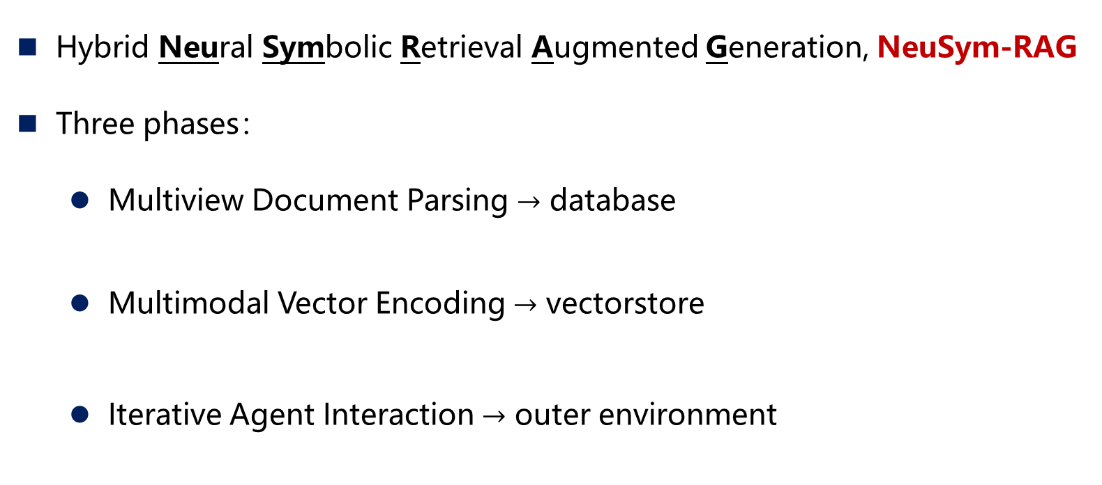
Method
Hybrid Neural Symbolic Retrieval Augmented Generation, NeuSym-RAG
Three phases：
  Multiview Document Parsing $→$ database
  Multimodal Vector Encoding $→$ vectorstore
  Iterative Agent Interaction $→$ outer environment
Multiview knowledge extraction
Organization of heterogeneous knowledge sources
Multimodal knowledge encoding
Unified planning and scheduling of heterogeneous knowledge sources

Slide 5
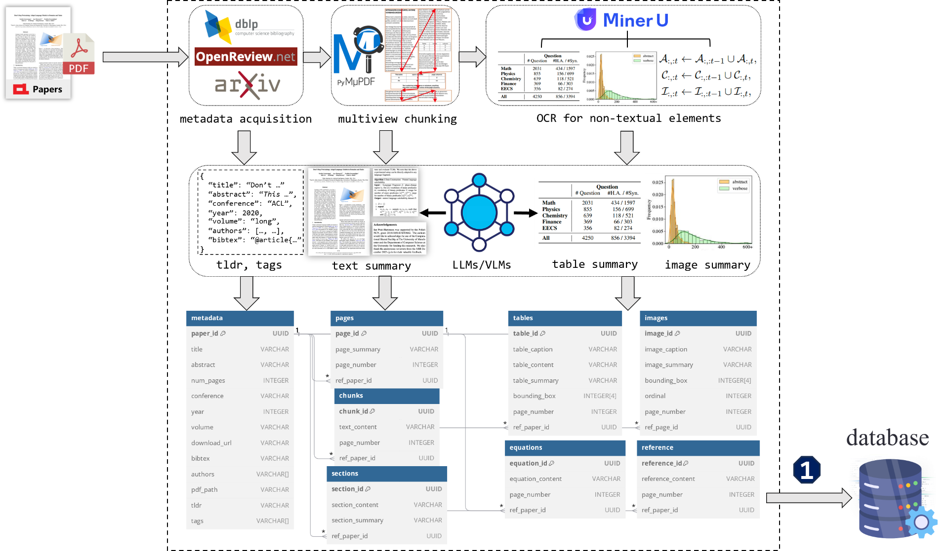
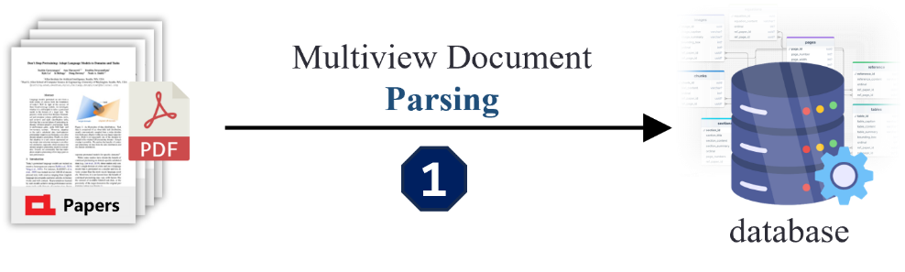
Method
Multiview knowledge extraction
Phase 1：Multiview Document Parsing → database
  Scholar API
  Text segmentation
  Paratextual extraction
  LLM-based summarization

Slide 6
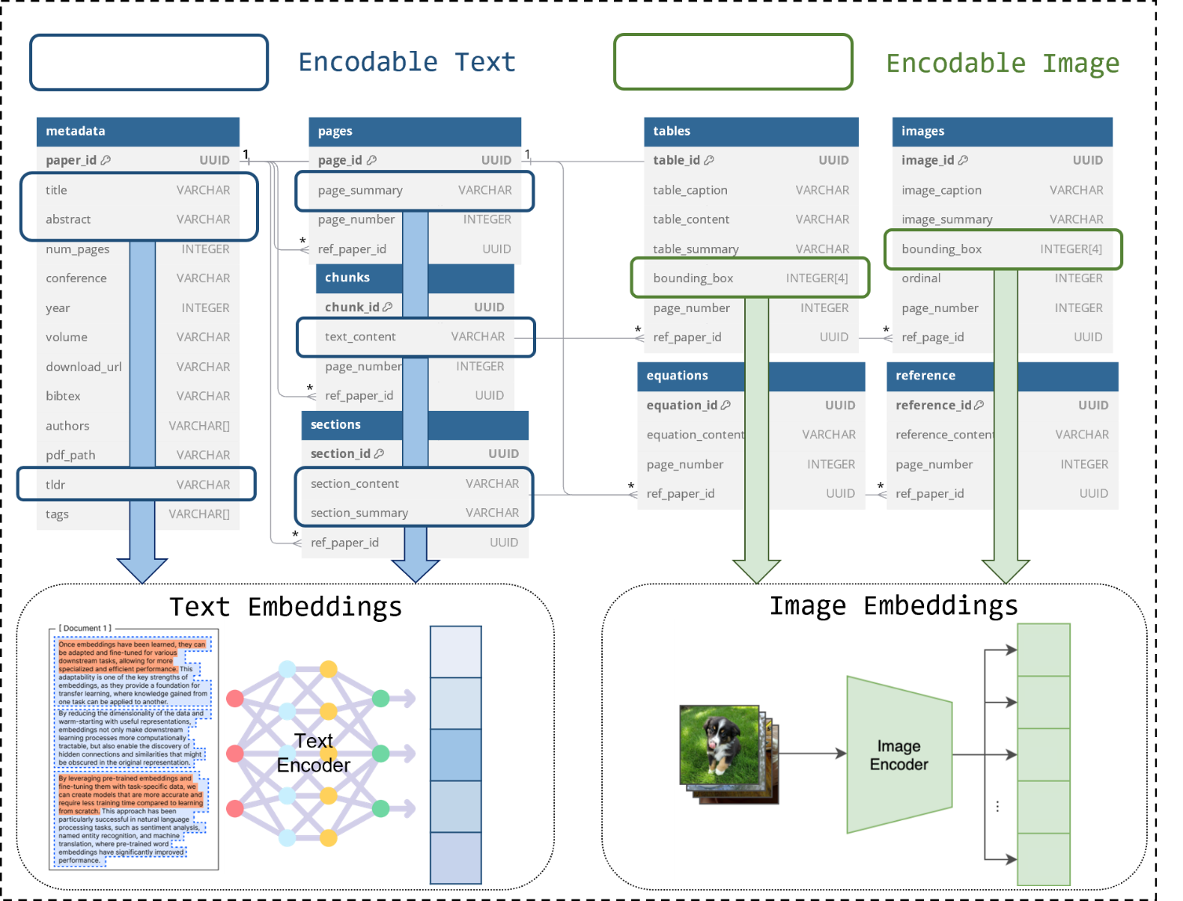
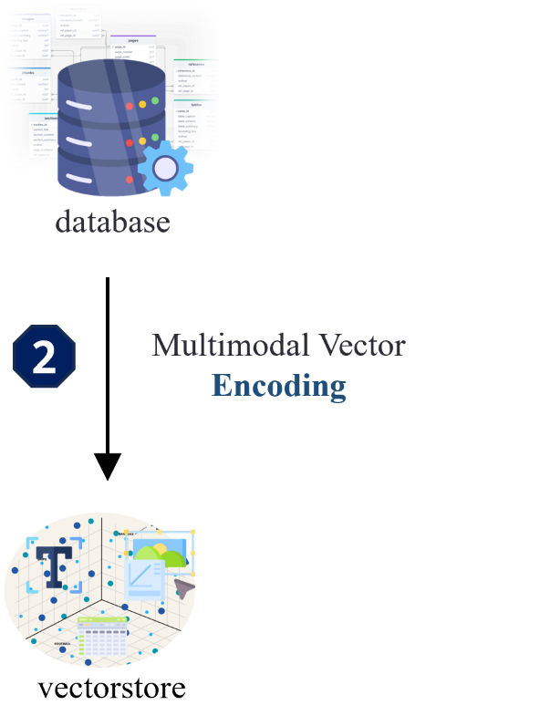
Method
Multimodal knowledge encoding
Phase 2：Multimodal Vector Encoding → vectorstore
  Identify encodable columns
  Apply modality-specific
  models for encoding

Slide 7
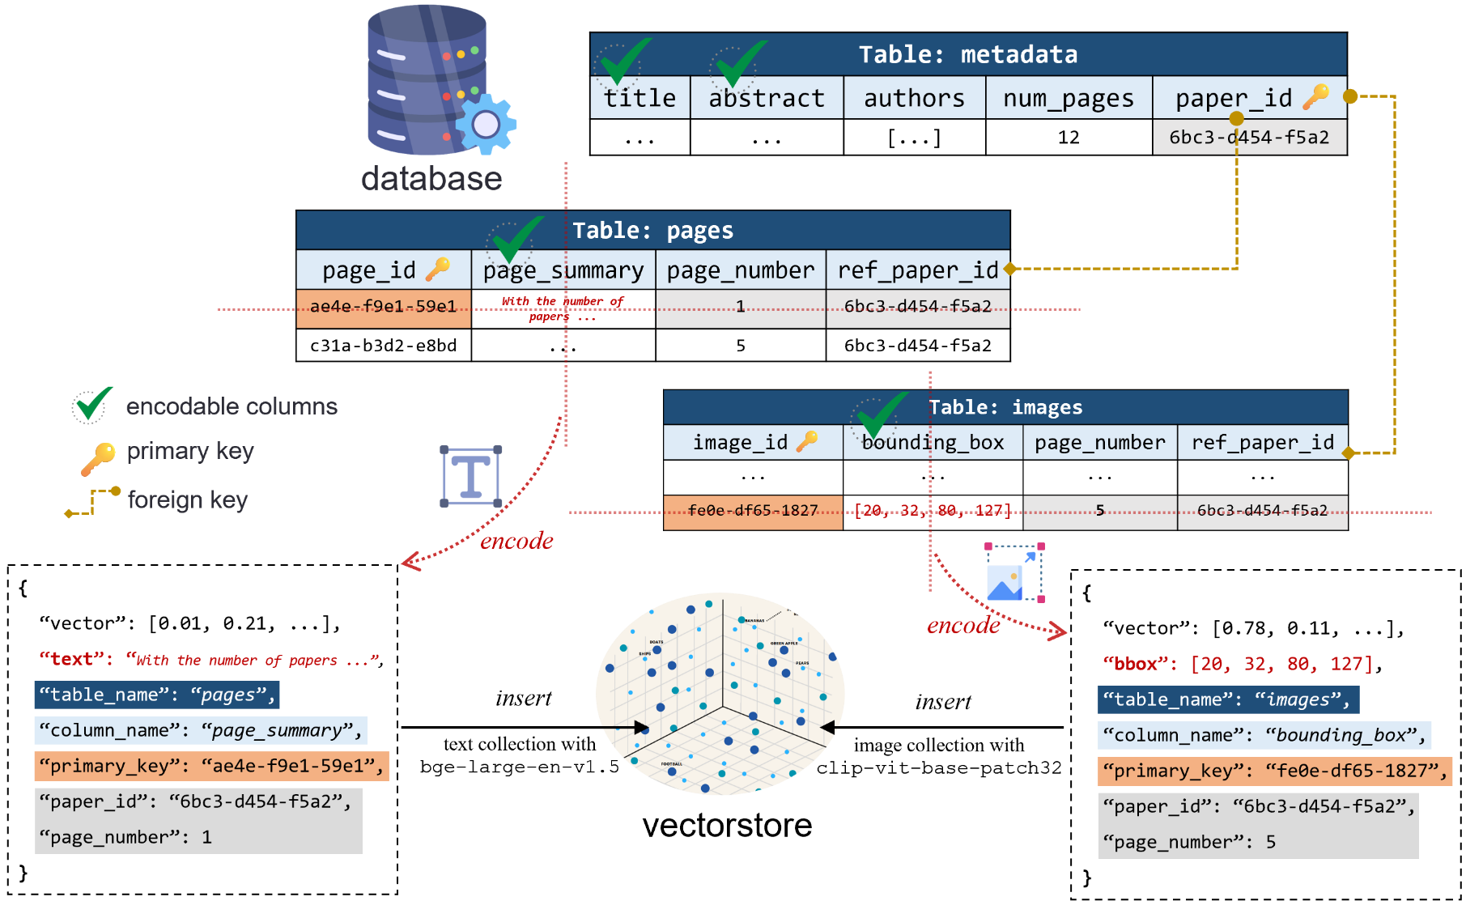
Method
Organization of heterogeneous knowledge sources
  Identify encodable columns
  Apply modality-specific models for encoding
  Build mappings between the database and the vectorstore
Phase 2：Multimodal Vector Encoding → vectorstore
    (table, column, primary_key)
Structured Indexing

Slide 8
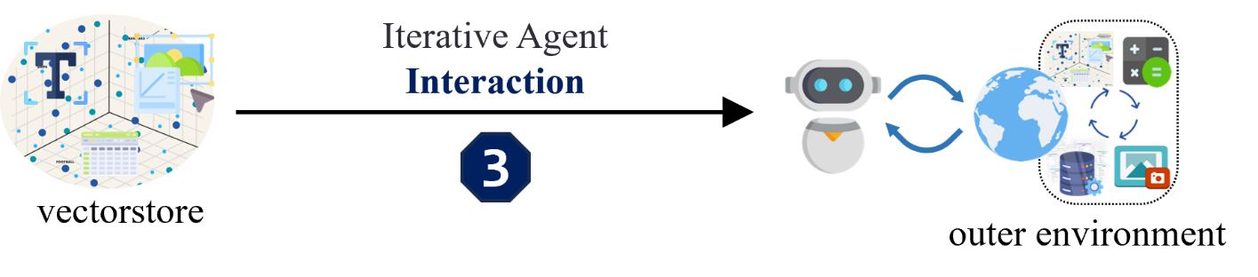
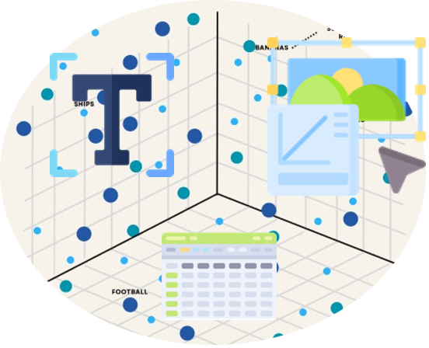
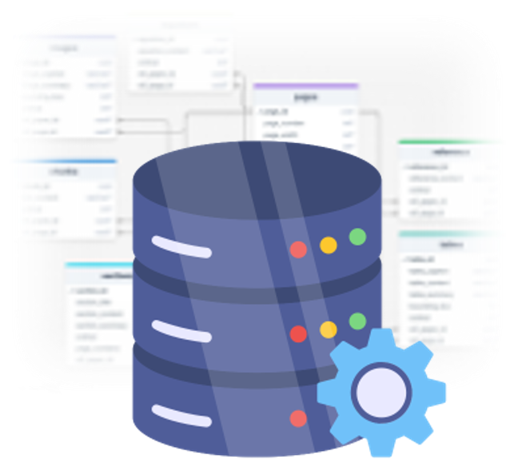

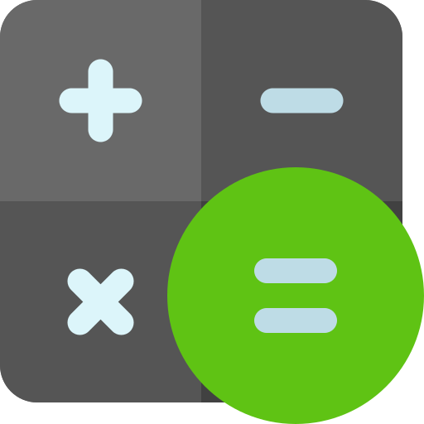


Method
Unified planning and scheduling of heterogeneous knowledge sources
Phase 3：Iterative Agent Interaction → outer environment
  Composition of environment
    heterogeneous knowledge sources
    external tools
vectorstore
database
image viewer
calculator

Slide 9
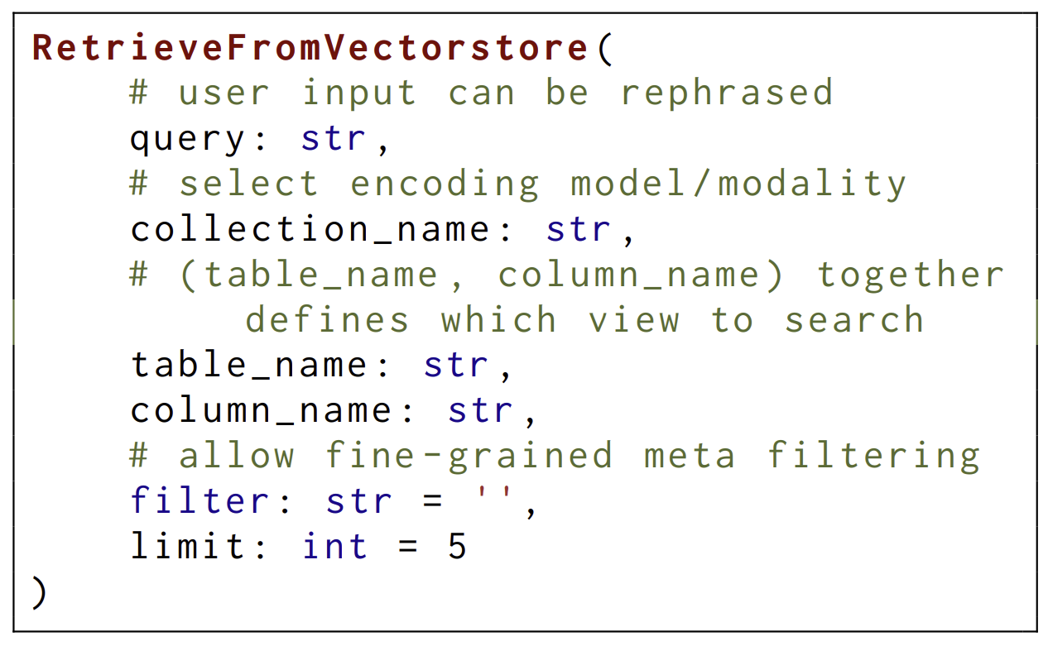
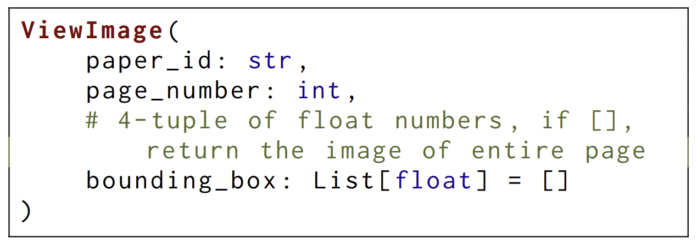
Method
Unified planning and scheduling of heterogeneous knowledge sources
Phase 3：Iterative Agent Interaction → outer environment
  Composition of environment
    heterogeneous knowledge sources
    external tools
  Interaction interface
    unified action format
    optional parameters

Slide 10
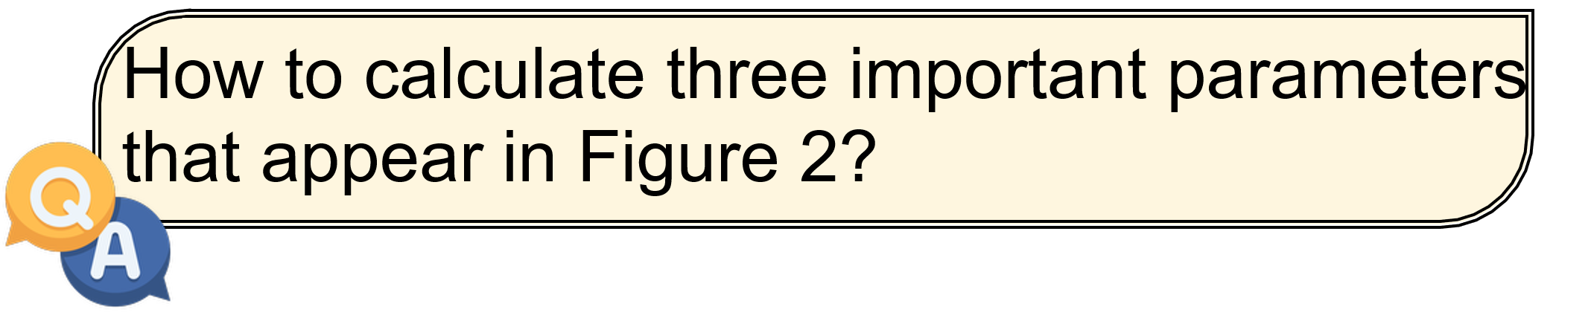
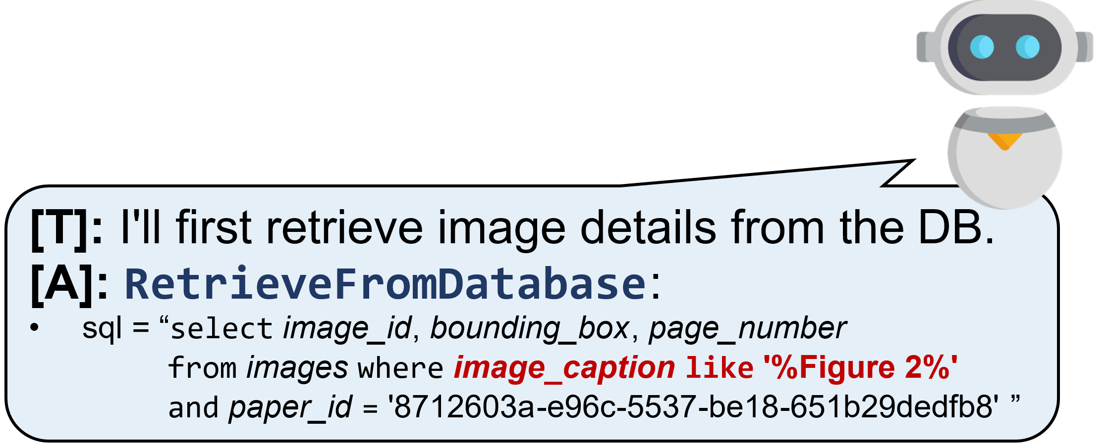
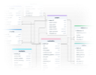


Method
Unified planning and scheduling of heterogeneous knowledge sources
Phase 3：Iterative Agent Interaction → outer environment
  ReAct (Yao et al., 2023) Think before action ([T], [A], [O])
database
Iteration 1

Slide 11




Method
Unified planning and scheduling of heterogeneous knowledge sources
Phase 3：Iterative Agent Interaction → outer environment
  ReAct (Yao et al., 2023) Think before action ([T], [A], [O])
[T]:
I will now view the image on that
page.
[A]:
ViewImage
:
•
paper_id
=
'8712603a
-
e96c
-
5537
-
be18
-
651b29dedfb8
'
•
page_number
=
image viewer
5
•
bounding_box
=
[69.0, 68.0, 527.0, 262.0]
[
O]
:
Iteration 2

Slide 12
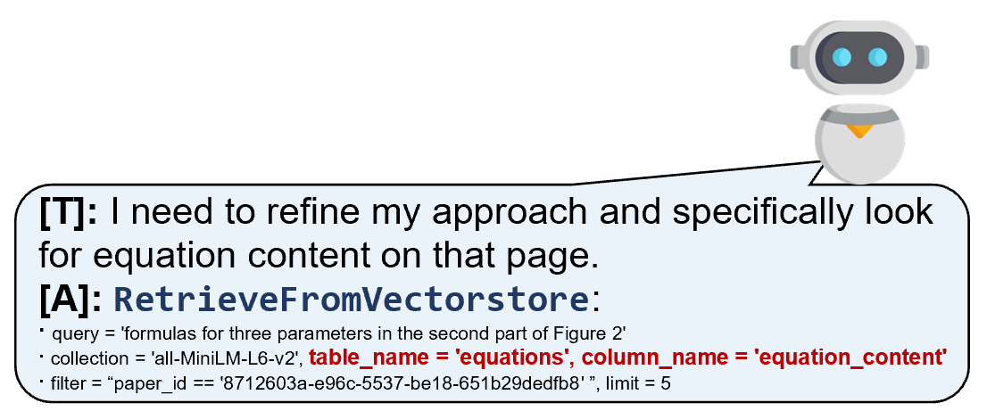
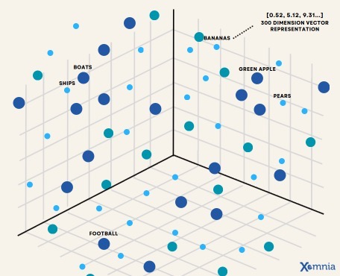



Method
Unified planning and scheduling of heterogeneous knowledge sources
Phase 3：Iterative Agent Interaction → outer environment
  ReAct (Yao et al., 2023) Think before action ([T], [A], [O])
vectorstore
id
score
text
[
O]
:
1
0.3168
Iteration 3

Slide 13
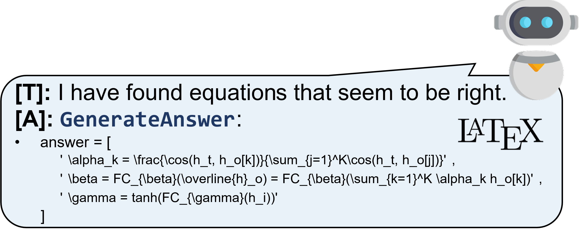

Method
Unified planning and scheduling of heterogeneous knowledge sources
Phase 3：Iterative Agent Interaction → outer environment
  ReAct (Yao et al., 2023) Think before action ([T], [A], [O])
Iteration 4

Slide 14
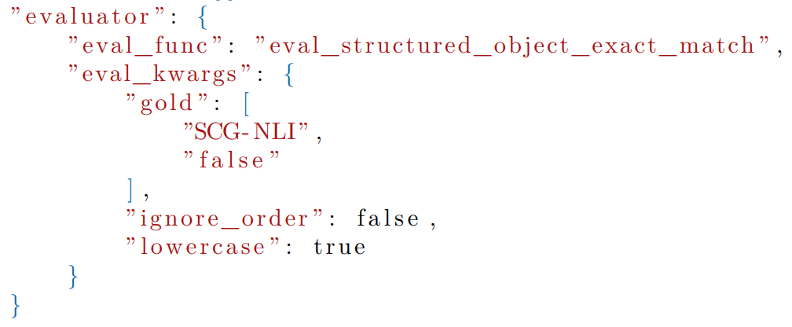
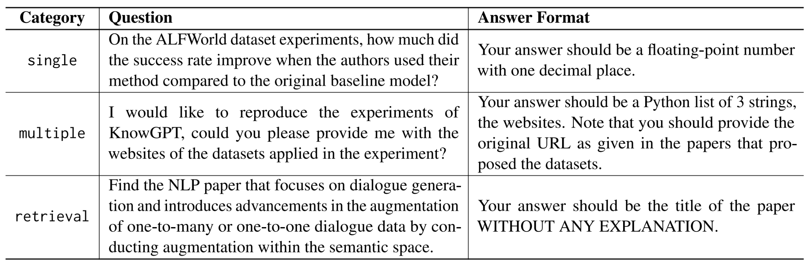
Experiment
PDF-based scholar QA datasets
  Manually annotated AirQA-Real
    3 question types + instance-specific evaluation + 553 examples
  M3SciQA (﻿Li et al., 2024a) 和 SciDQA (﻿Singh et al., 2024)
objective evaluation function

Slide 15
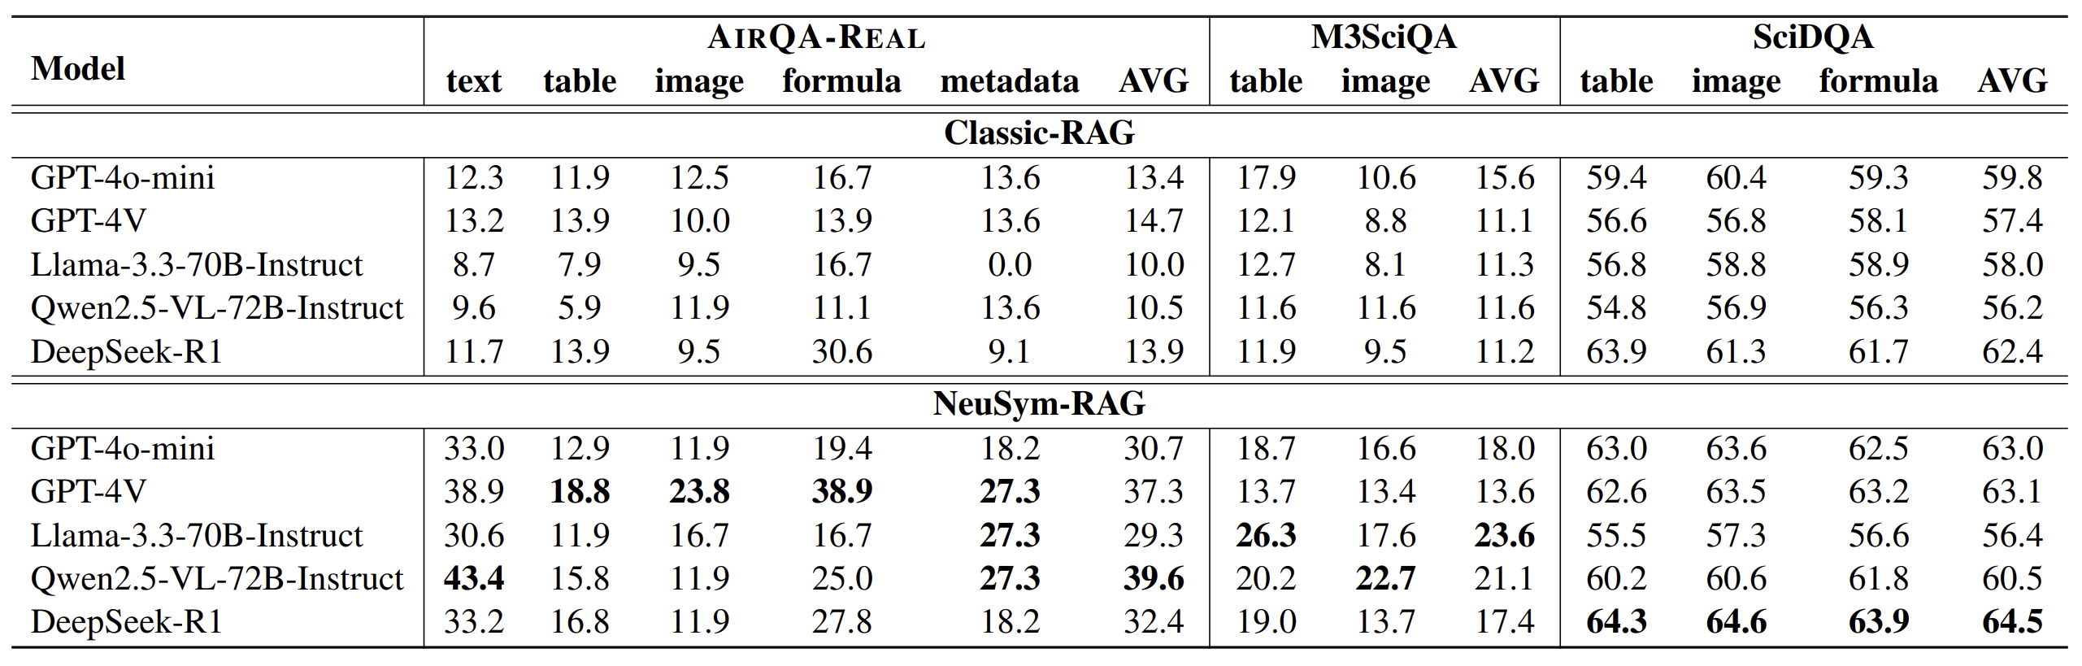
Experiment
Main experiment: different LLMs
﻿NeuSym-RAG remarkably outperforms Classic RAG on all three datasets.
﻿VLMs perform better in tasks that require vision capability.
﻿Open-source LLMs are capable of handling this complicated interactive procedure in a zeroshot paradigm, and even better than some closed-source LLMs.

Slide 16
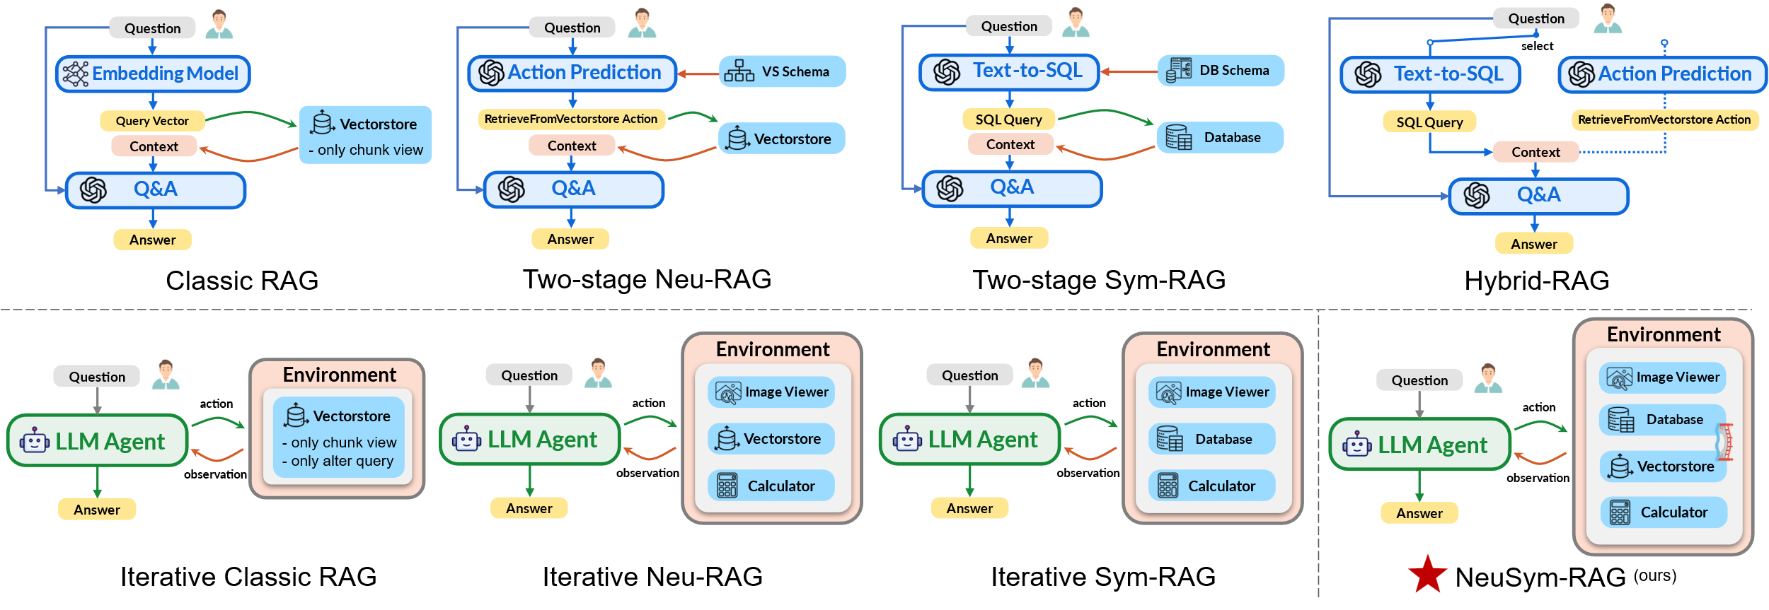
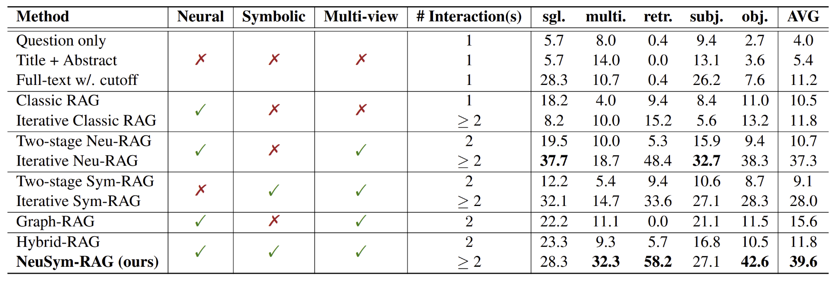
Experiment
Main experiment: different baselines
  Symbolic/Neural?
  Multi-view?
  Iterative?
﻿﻿Two-stage Neu-RAG (multiview) beats Classic RAG.
Hybrid RAG (more views) improves further.
﻿﻿Iterative methods outperforms two-stage ones.
﻿﻿As turn increases, objective score rises faster.

Slide 17
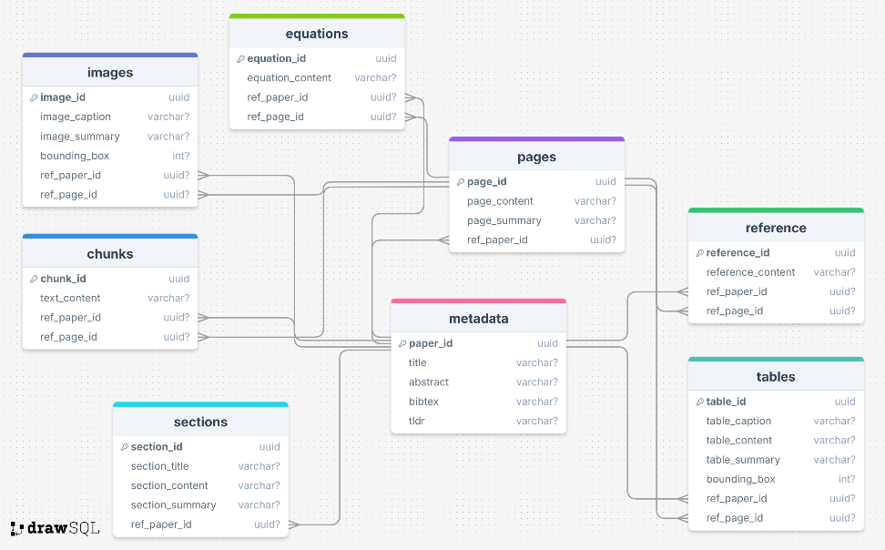
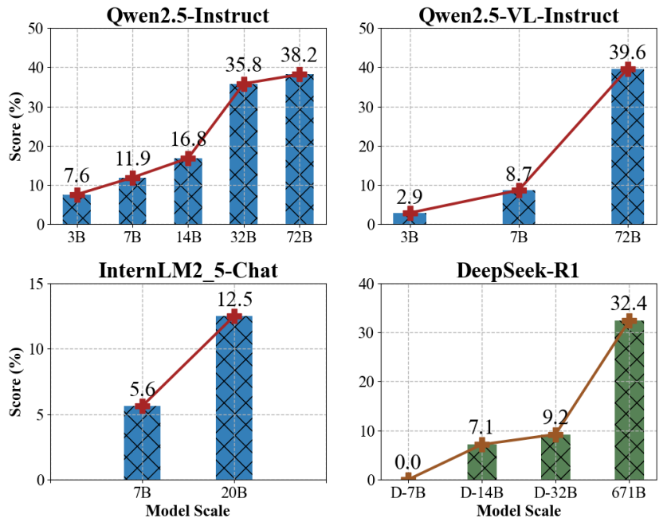
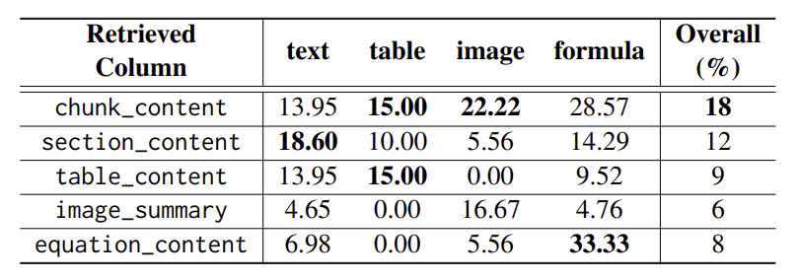
Experiment
Ablation study:
(table_name, column_name)
Different model size
Applying different views in Classic-RAG
﻿The performances consistently improve as the scales of LLMs increase.
﻿﻿The classic chunking strategy is still the best in general. However, chunking views tailored to specific aspects may achieve the best results in their particular categories.

Slide 18
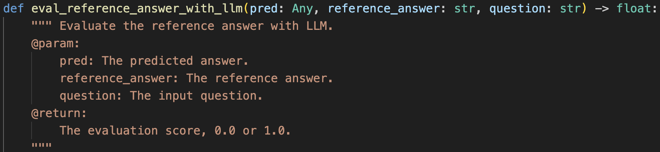
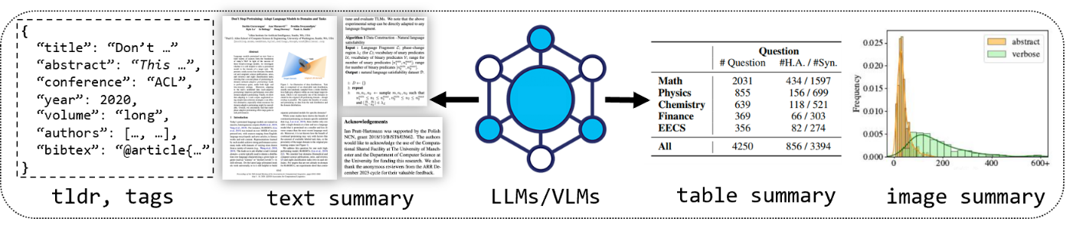
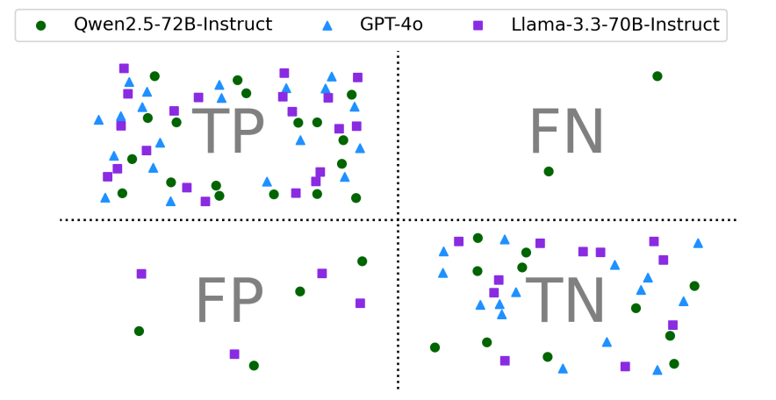
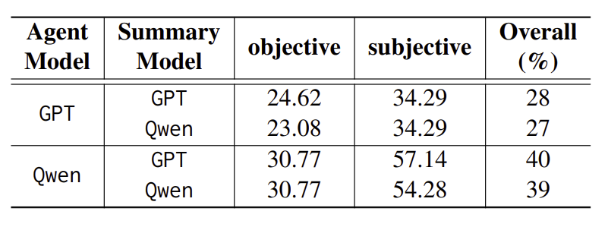
Experiment
Ablation study:
Different summary model
Consistency with human judgements
Summary generation: Open-source LLM appear to be a viable alternative to closed-source ones.
Subjective evalution: Closed-source LLM aligns better with human judgments.

Slide 19

Thank you for listening!
Our Demo

