Slide 1

AirQA: A Comprehensive QA Dataset for AI Research with Instance-Level Evaluation
Tiancheng Huang, Ruisheng Cao, Yuxin Zhang, Zhangyi Kang, Zijian Wang,
Chenrun Wang, Yijie Luo, Hang Zheng, Lirong Qian, Lu Chen, Kai Yu

Slide 2
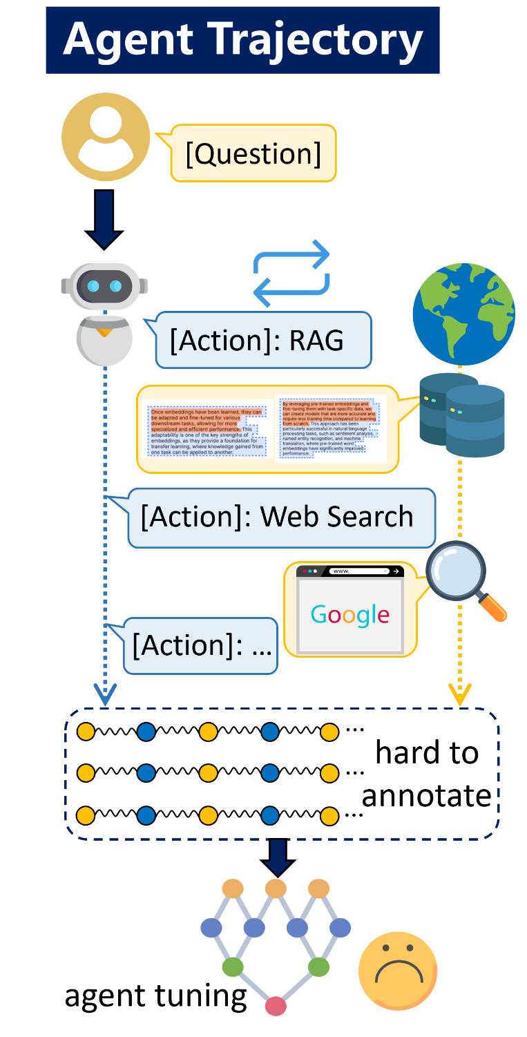
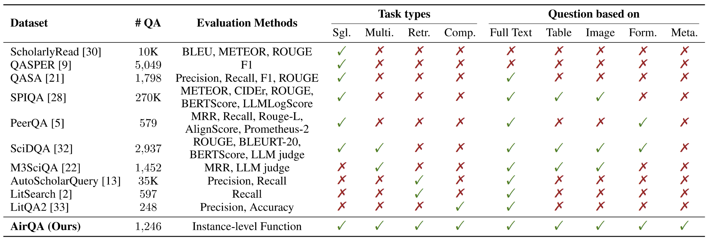

Motivation
textual & paratextual
understanding
long-term planning & reasoning
retrieve relevant paper
Lack of combined evaluations of the three capabilities above!

Slide 3
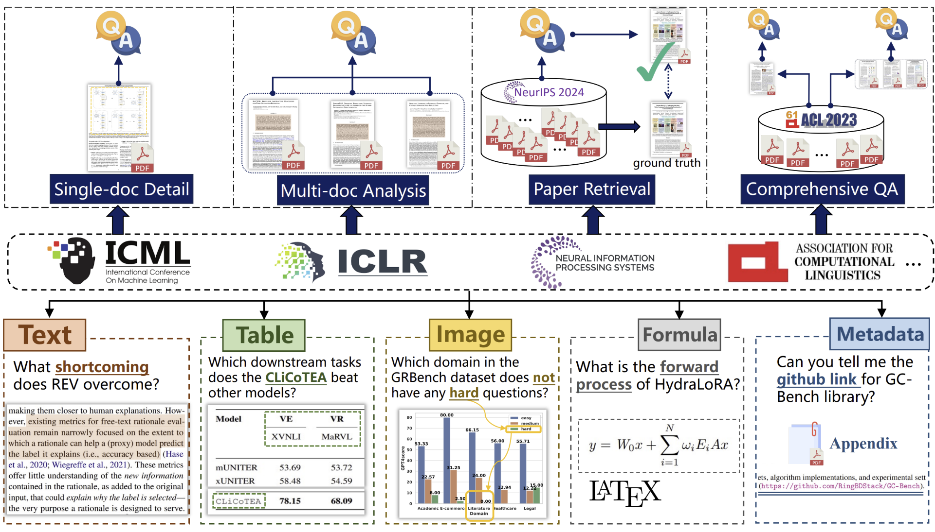
AirQA (AI Research Question Answering)
Multi-task & Multi-modal

Slide 4
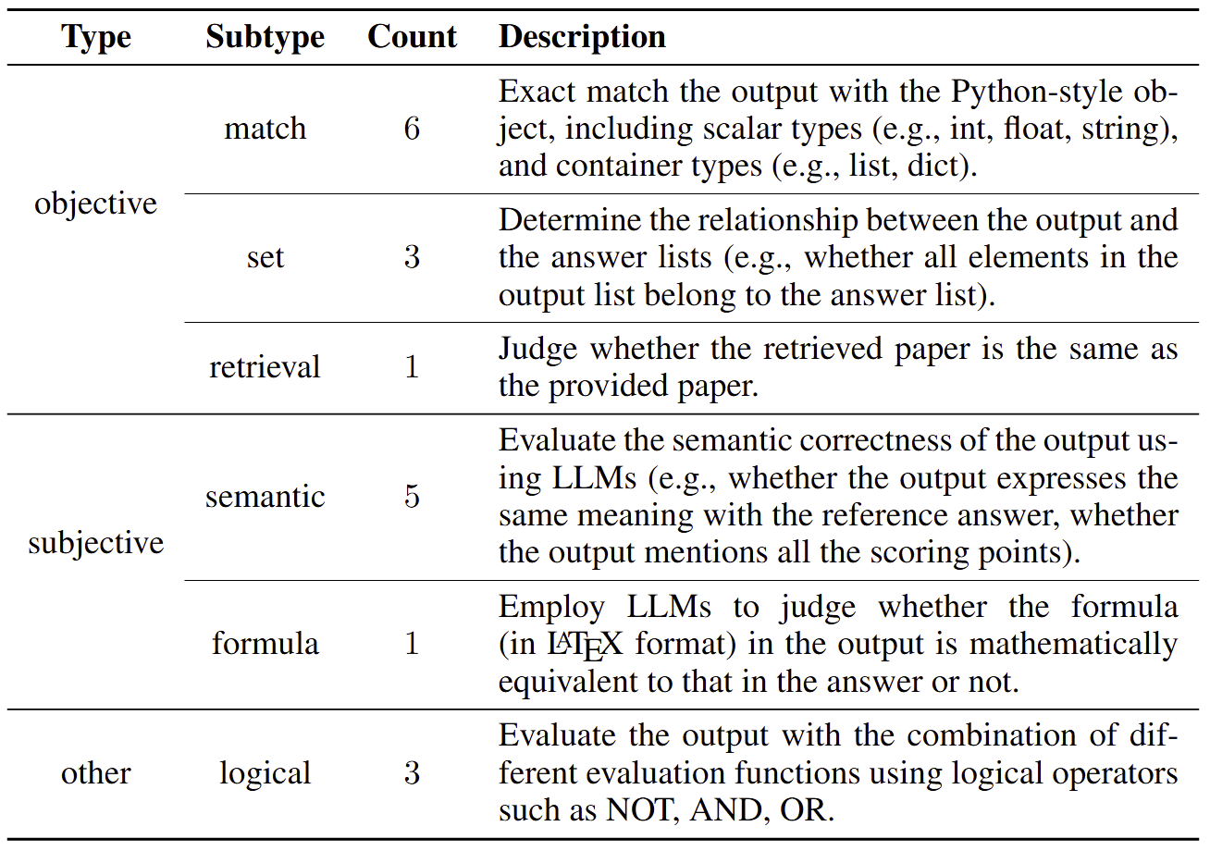
AirQA (AI Research Question Answering)
Evaluation
Output reformatting
Instance-level parameters
{
"example": {
"eval_func": "eval_string
_exact_match",
"eval_kwargs": {
"gold": "Italian",
"lowercase ": true
}
}
}

Slide 5
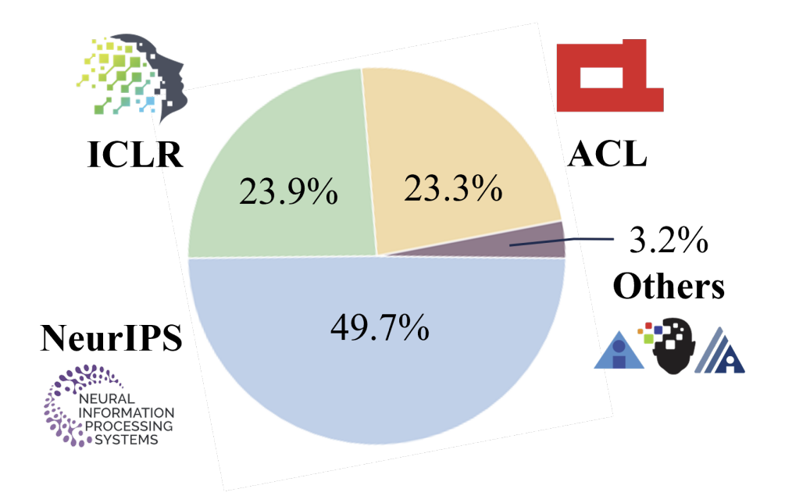
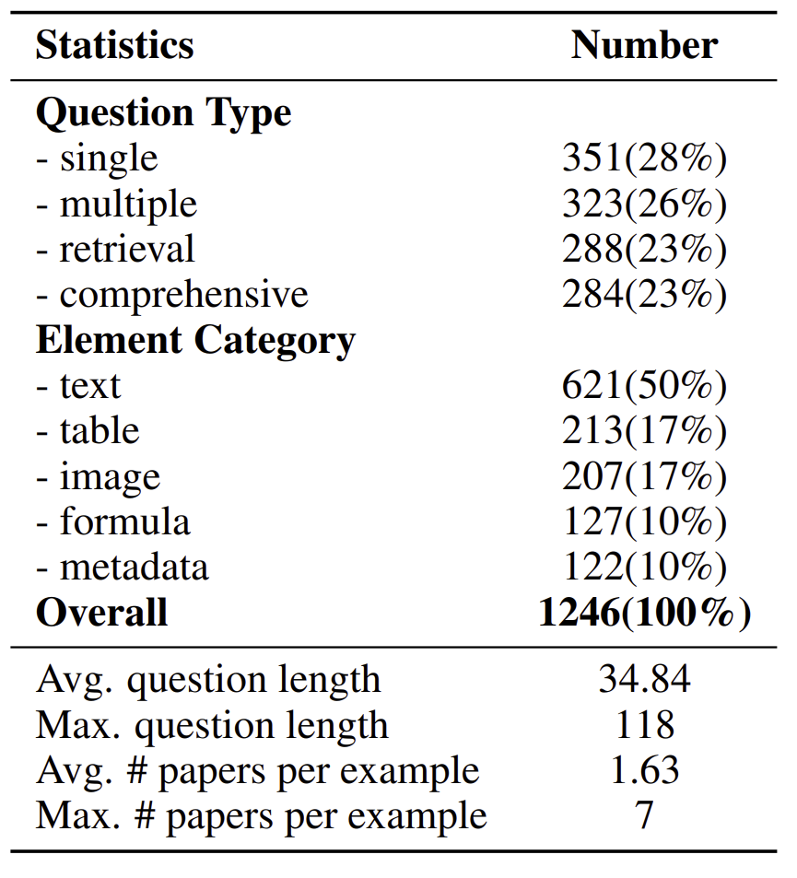
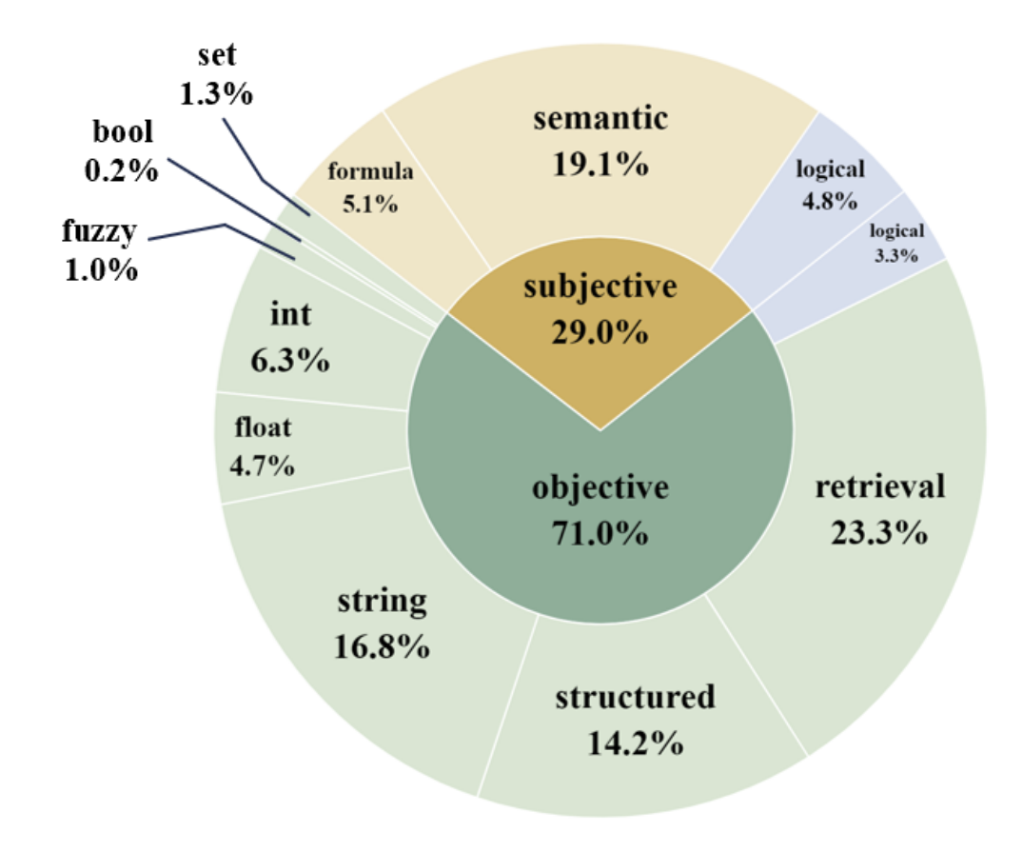
AirQA (AI Research Question Answering)
Statistics
1,246 questions; 13,956 papers;
spanning 7 conferences over 16 years

Slide 6
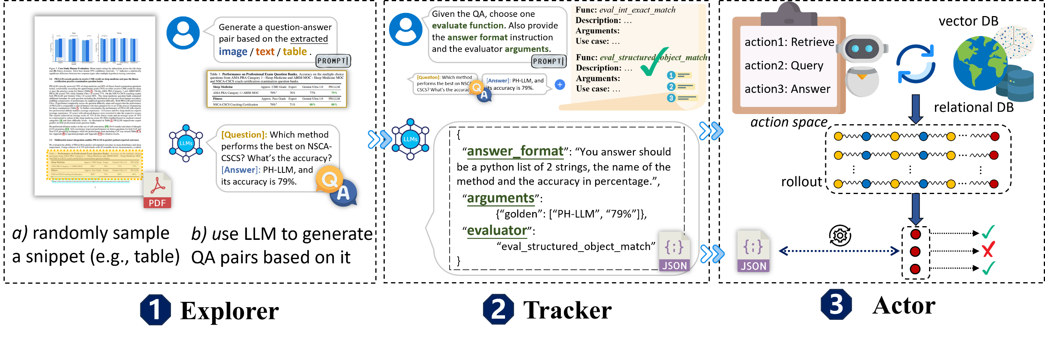
ExTrActor (Explorer-Tracker-Actor)
Human-like three-stage trajectory synthesis framework
The whole process is conducted by LLMs, with no manual annotation involved.

Slide 7
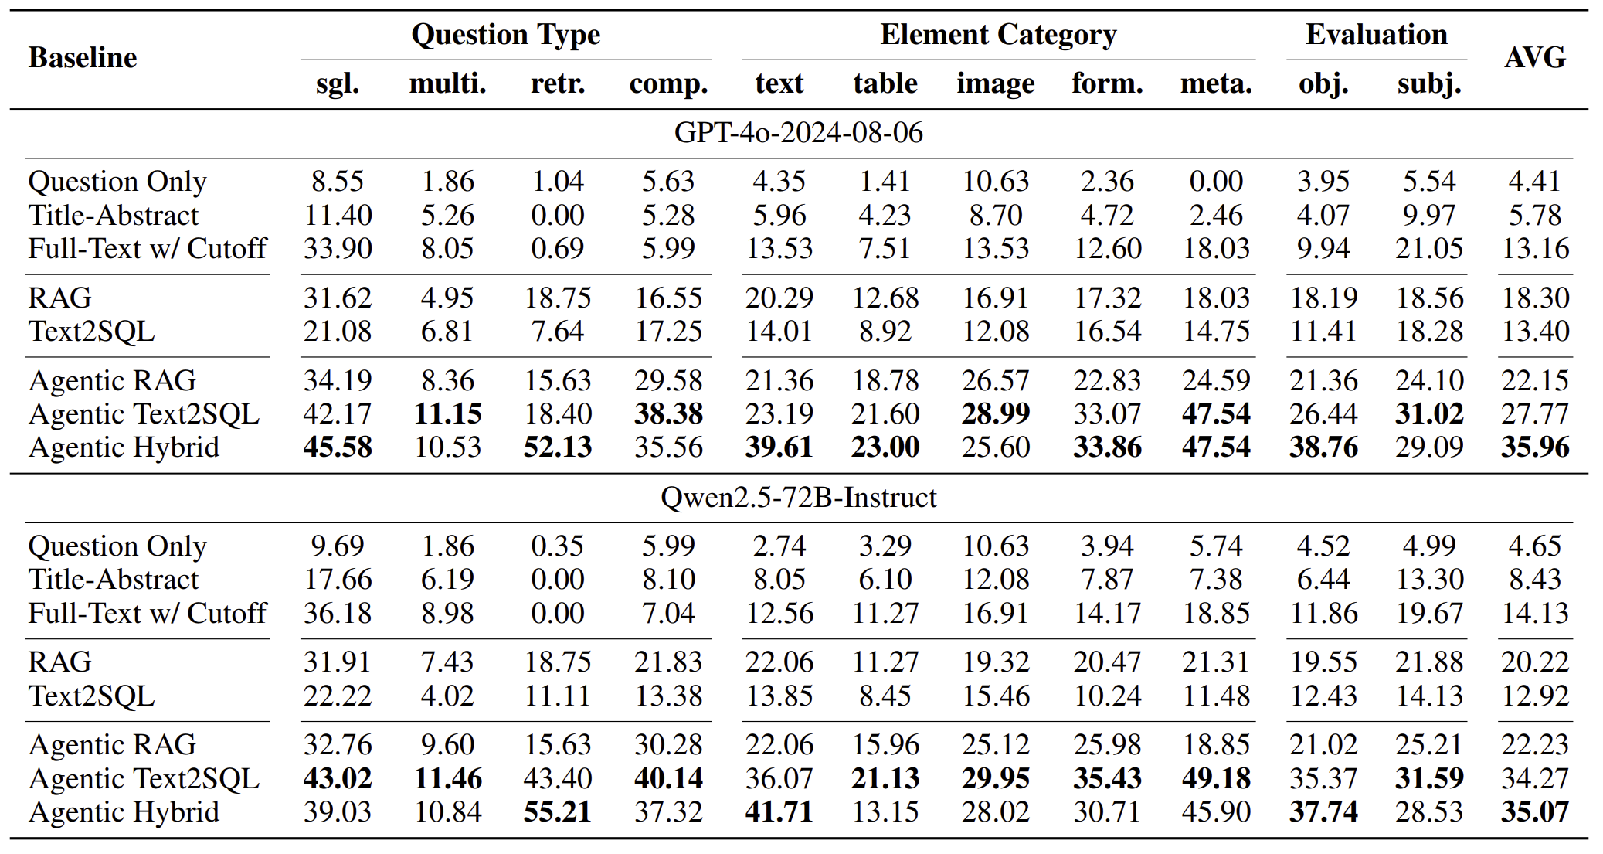
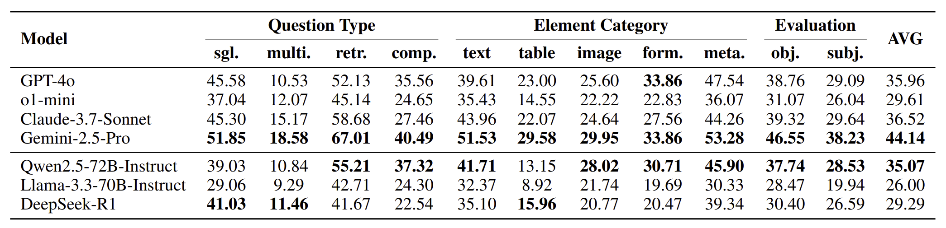
Experiment
AirQA
Baselines with DB & VS
ReAct-style Agent
Result
Best model only 44.14%
More information ✔
More interactions ✔
Proprietary > Open-source
Reasoning: not satisfactory

Slide 8
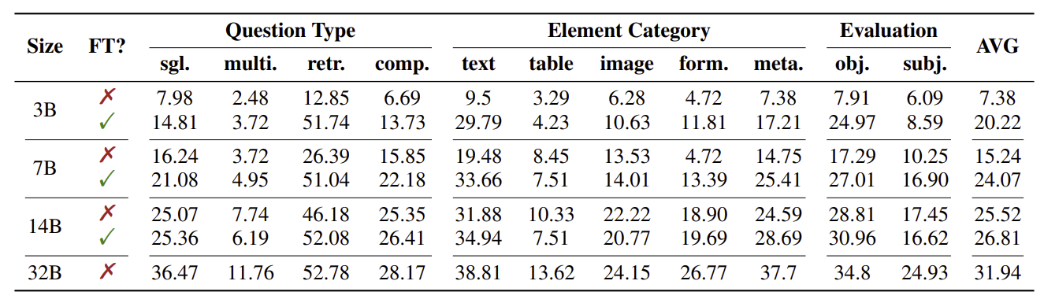
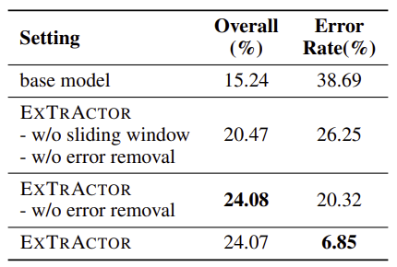
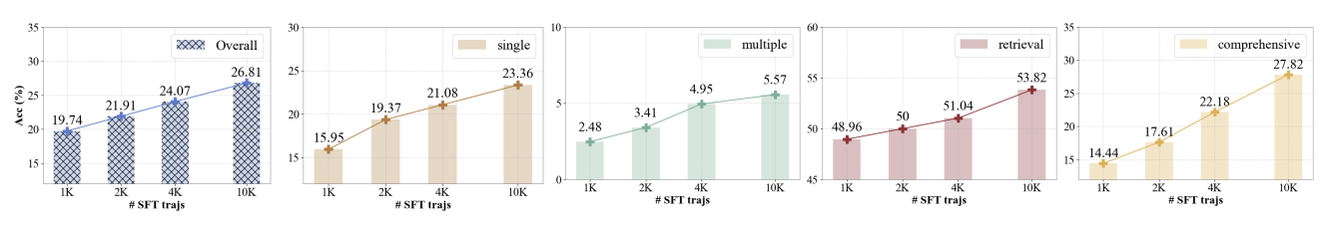
Experiment
ExTrActor
Fine-tuned 3B > Untrained 7B
Scalability ✔ ● Error rate ↓

Slide 9

Thank you for listening!
Our Website

